Slide 1
CREDIT CARD DEFAULT CLASSIFICATION
Santhosh Kumar K S

Slide 2
Objective
Financial threats are displaying a trend about the credit risk of commercial banks as the incredible improvement in the financial industry has arisen. In this way, one of the biggest threats faces by commercial banks is the risk prediction of credit clients. Objective is to develop machine learning models to predict the probability of credit default based on credit card owner's characteristics and payment history.

Slide 3
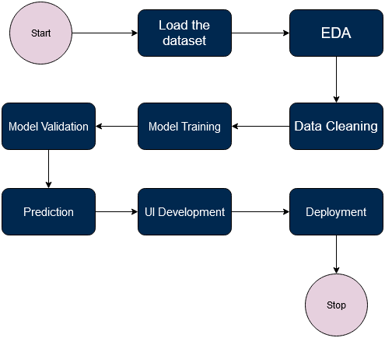
ARCHITECTURE

Slide 4
EDA and Data Preprocessing
Getting insights about the data using some visualization plots.
Data preprocessing helps to convert raw data into machine trainable format. This involves Null values treating, Outlier , Scaling, Feature Transformations etc.
This dataset is imbalanced we make this dataset as balanced using SMOTE.

Slide 5
MODEL TRAINING
Dataset is spitted into two parts training and testing set.
Trained various algorithms, KNN, Logistic Regression and CART algorithms, in that XGBoost, CatBoost and Gradient Boosting algorithms gives Good Result.
Using these three models trained stacking classifiers with different combination. Saved the model has higher accuracy, no over fitting and higher AUC-ROC-SCORE.
Used Feature Forward selection from sklearn to select best k features. And trained using these features and saved the model for production.

Slide 6
PRODUCTION
Developed UI using HTML and CSS. And Backend using Flask web framework.

